Slide 1
Cleaning up Low Earth Orbit:
A System Design Application for Space Debris Removal
Davis Huffman
Taylor Ribeiro
Taylor Gregory
EMSE 6099
Notes:
T.R.

Slide 2
Problem Statement
(A) Deliverable | (B) Content | (C) WC
Issue | There are over 27,000 pieces of space debris orbiting earth | 10
Reference | Garcia, M. (2015, April 14). Space debris and human spacecraft. NASA. Retrieved October 26, 2022, from https://www.nasa.gov/mission_pages/station/news/orbital_debris.html | NA
”so what” | resulting in hazardous conditions for human space flight and robotic missions. | 11
Reference | Davis, L. (2021,April 14). Space Junk Removal Is Not Going Smoothly. Scientific American. Retrieved October 26, 2022. https://doi.org/10.1038/scientificamerican01151848-136k | NA
Problem Statement | There are over 27,000 pieces of space debris orbiting earth resulting in hazardous conditions for human space flight and robotic missions. | 21
Industry | Aerospace | NA
PS Elaboration 1 | Robotic missions would include that of satellites and the traffic risks that accompany them. | 14
PS Elaboration 2 | If space debris continues to accumulate at its current exponential rate, windows of human space flight will narrow further. | 19
Notes:
T.R.

Slide 3
Thesis Statement
(A) Deliverable | (B) Content | C) WC
Thesis Statement | A software-based decision-making tool will be needed to aid engineers in designing a system to reduce space debris, resulting in a decrease of satellite loss and hazards for manned flight missions | 30
Research Product | Software-based decision-making tool | 5
Format | Python | 1
Deliverable Usage | Utilized by aerospace agencies (NASA, ESA, etc.) when they develop systems to clean LEO (low-earth orbit) hazardous space debris | 19
PS Tie Back | A software tool to assist in development of a mechanical system to help eliminate debris in low earth orbit. | 19
New contributions | A decision-making software powered by a database of internal research, that takes inputs and queries from end-user and provides a recommended system design solution | 25
Scope | Aerospace communications impact geo-location prominently used by government, military, and the average public space. | 15
Notes:
T.G.

Slide 4
List of Artifacts for Space Cleanup System Designer Project
Course | Artifact
EMSE 6815 | Requirements Document
EMSE 6805 | Decision Tree
EMSE 6805 | SWOT Analysis
EMSE 6410 | Break Even Analysis
EMSE 6801 | Functional Decomposition
EMSE 6825 | Schedule
EMSE 6840 | OV-1
EMSE 6805 | WBS
EMSE 6825 | Stakeholder Analysis
EMSE 6817 | ERD Diagram
EMSE 6805 | Screen Mockups
EMSE 6817 | Software Pathing Diagram
Notes:
D.H.

Slide 5

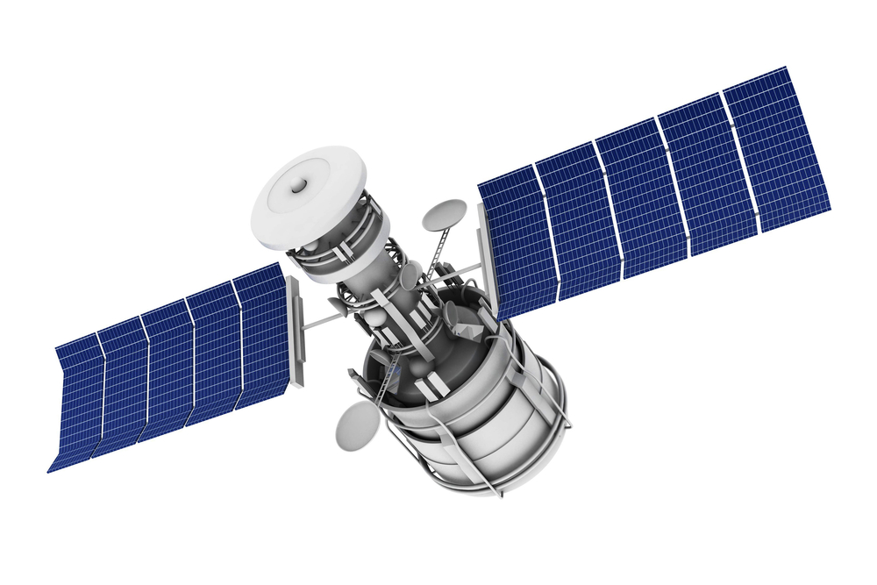


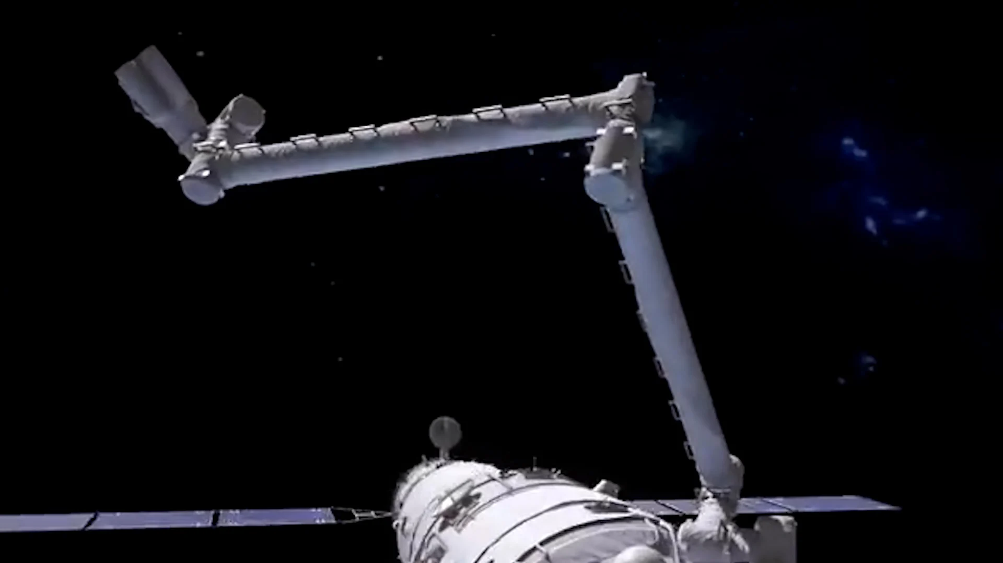




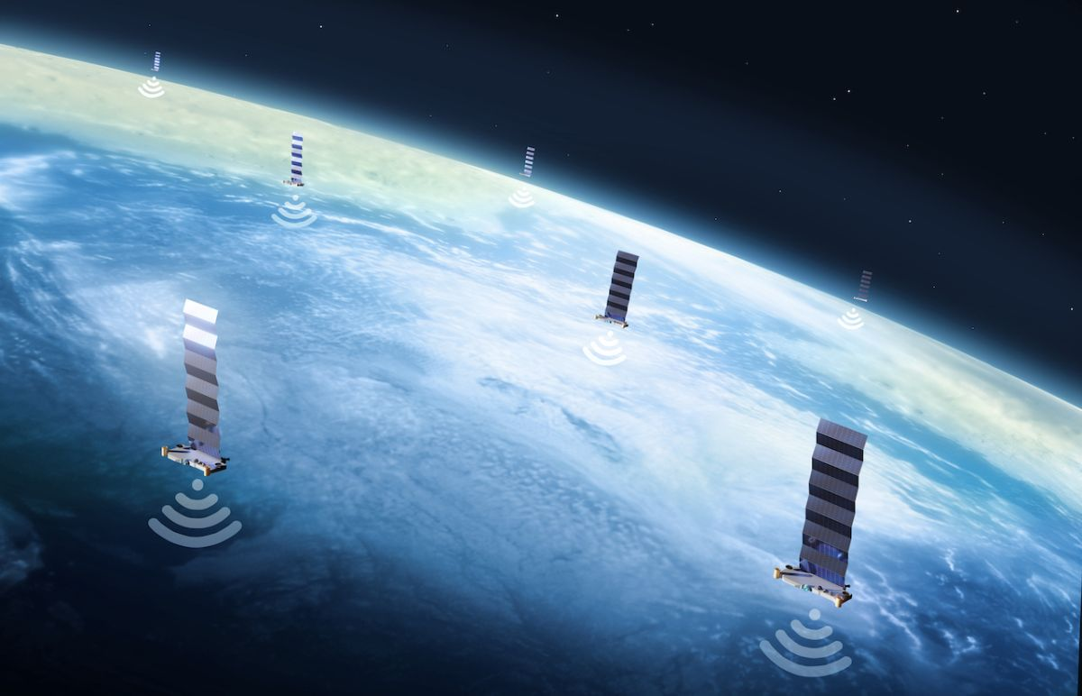
OV-1
Space Debris
Satellite At Risk
Research and Data on Technologies
Proposed Software
Military and Location Services and Public Technologies/Services
Spacecraft Design
Company Manufacturing
Consumer / User (Associated with Company)
Notes:
D.H.
Spell out software user
Military, Location Services, and Public Technologies/Services

Slide 6
Stakeholder Analysis
Keep Informed
Low Power, Low Interest: Stakeholders external to the project execution, but share interest in the project outcomes
General Public
Science Communities
Keep Satisfied
Future Users
High Power, Low Interest : Stakeholders who contribute in some way to outcomes of the project. But not super interested in knowing all the details.
Foreign Space Agencies
Researchers
Financial Sponsor
US AF
NASA
SMEs
Project Management
High Power, High interest: Stakeholders who are essential to the successful execution of the project, and are very interested in the details of the project.
Manage Closely
Software Engineers
Systems Engineers
Notes:
T.R. Power vs interest?

Slide 7
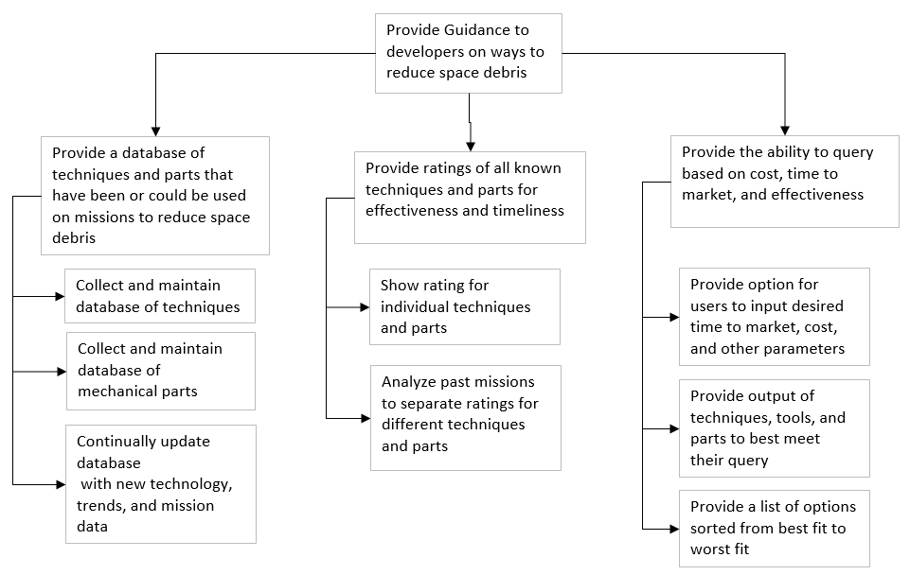
Functional Decomposition
Notes:
T.G. Table might be easier to read
Reliability go bye bye -> user selection and preference

Slide 8

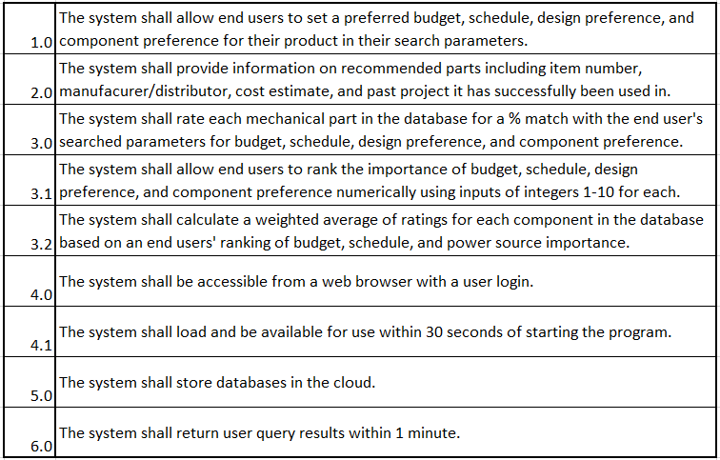
Notes:
T.G. Same comment as previous slide w/ reliability
By - software engineers and researchers
Soln based requirement
Type of requirements

Slide 9
Software Pathing Diagram
Budget
Schedule
Design Preference
Component Preference
Sub-Component Preference
0-1 year
1-5 years
5+ years
Fuel Based
Low to Mid $
No Specific Component Choice
Electric
User initiates Software
Mid to High $
No Specific Sub-Component Choice
Solar Panels*
High to Very High $
64KwH Solar Panel Batteries*
(* indicates example of one component preference, there are many more)
Notes:
Cost effective = budget
Timelines = schedule
Specific Technologies / Desired component
Type of design choice
Percentage solution

Slide 10
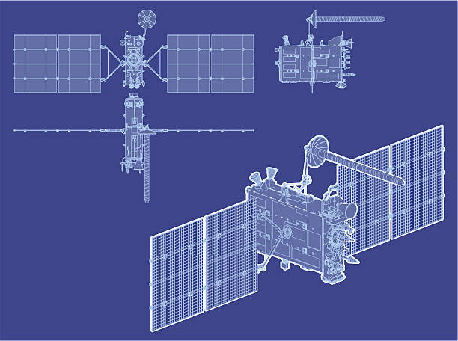
Screen Mockups
x
Space Cleanup System Designer - Specification Input
1.1: Budget
Please enter estimated preferred budget in USD:
High
$
Low
$
Next
Space Cleanup System Designer - Blueprint Viewer
x
x
Based on the inputs specified, the recommended system is: An Optimized Mechanical System
Design: | Mechanical
Component: | Solar Panel
Budget: | High
Schedule: | Short
Click next to learn more about this system
Next
Notes:
T.R.

Slide 11
ERD
Mechanical System
Robotics
Fuselage
Material
Collection
Destruction
Longevity
Collection/Destruction System
Robotic Arm
Gel Mechanism
Net System
Burn System
Diversion System
Electrical System
Motherboard
Communications
Spatial Awareness
Computing
Power
Resistors
Data Storage
Longevity
Overall System
Connections
Capability
Interoperability
Data Transfer
Autonomy
Item Collaboration
Corrosion
Latency
Propulsion System
Boosters
Orientation
Fuel
Engine Type
Distance
Range
Notes:
D.H.

Slide 12
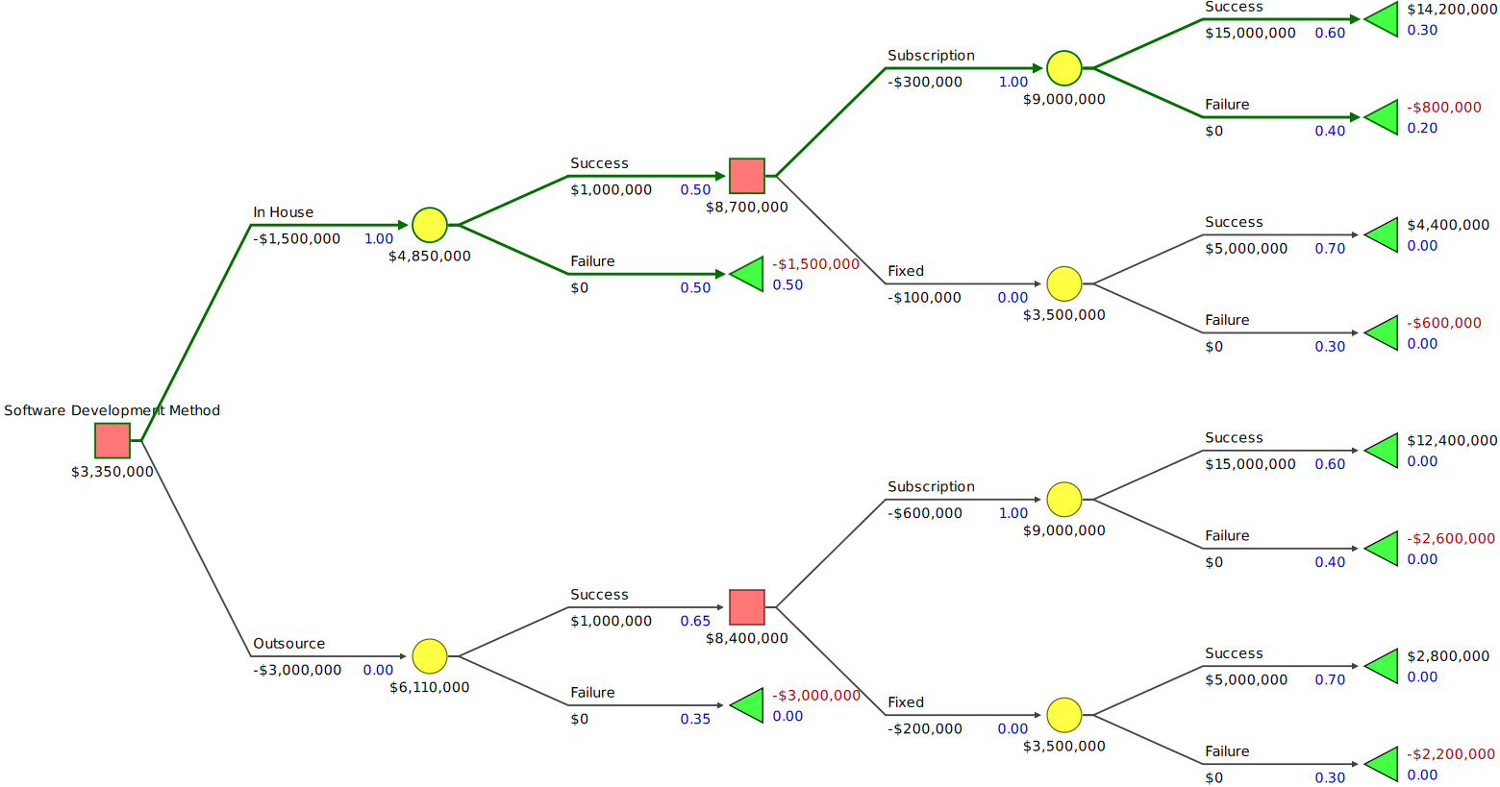
Decision Tree

Slide 13
SWOT
Strength Information is consolidated from all governments and organizations involved in space debris clean up | Weakness Database needs to be continually updated with latest information to remain useful
Opportunity Encourages competition and promotes research and documentation on the subject | Threat Some information could be subject to security clearance
Notes:
Opportunity rework - might encourage competition, help solve the problem. Promotes research and documentation

Slide 14
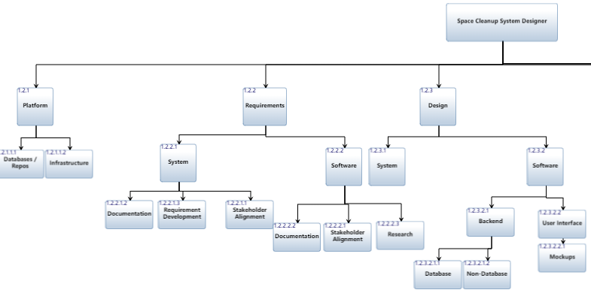
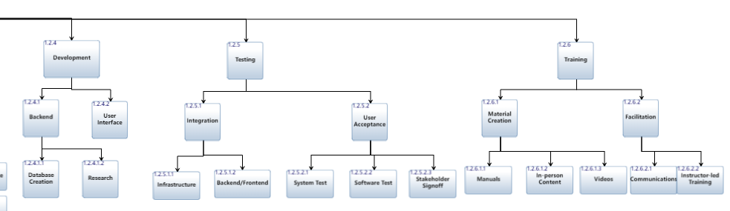
Work Breakdown Structure (WBS)
Part 1
Part 2
Notes:
Bottoms Up Estimation

Slide 15
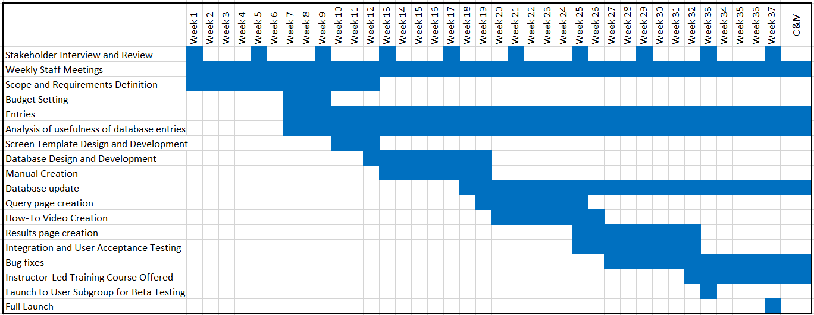
Schedule
(Kytainyk, 2022)
Notes:
T.G.

Slide 16
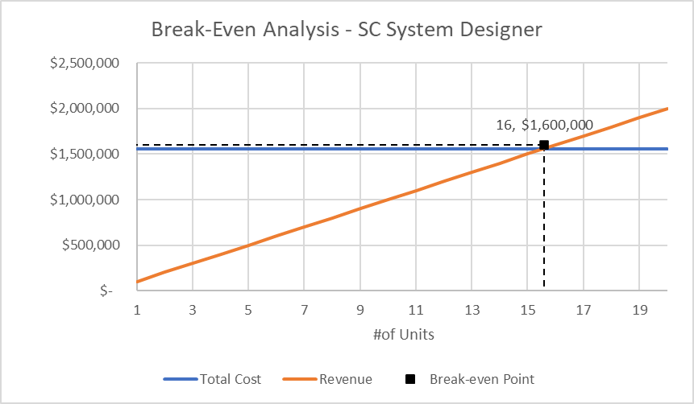
Break-Even Analysis
Notes:
1 year license subscription (Fixed costs/ (price - variable costs) Analogous Estimation for Costs https://www.spheregen.com/cost-of-software-development/ Assume SW Eng 120k / year, ½ year til drop, 60k per engineer, 4-5 engineers 1-2 FE, 1-2 BE, 1-2 research / data input engineers

